Slide 1
Calorie
Team 25 - 4 PTC

Slide 2
About us
Jiabin Xiong jiabinx@uci.edu
Major: Computer Science
Year: Senior Student
Experience with Android before: Lab5 in ICS45J
Jiawen Ye jiaweny7@uci.edu
Major: Computer Science
Year: Senior Student
Experience with Android before: No experience before.
Xinjin Hua xinjinh1@uci.edu
Major: Data science
Year: Senior Student
Experience with Android before: Do not have Android development experience before.
Yingchen Zhou yingcz1@uci.edu
Major: Computer Science
Year: Senior Student
Experience with Android before: Calorie is the first app that I’ve ever made.

Slide 3
Motivation
People cannot walk outside due to the global pandemic
The time of exercise is reduced
Cause a negative impact on their bodies
How do people stay healthy while spending less time on working out?
Reducing calories intake
Wise food choices

Slide 4
Problem
Different people have different body parameters
Different needs of nutrition consumptions
Nutrition facts may not be available
Some foods have nutrition facts
What about other foods?
Tracking process is tedious
Find the nutrition facts of each food is time-consuming
Do math whenever having a meal
Extra time on deciding what can eat
What should we eat may become a tough question
What can we eat without eating too much?
Some Health Apps are not easy to use
Require too many inputs for users

Slide 5
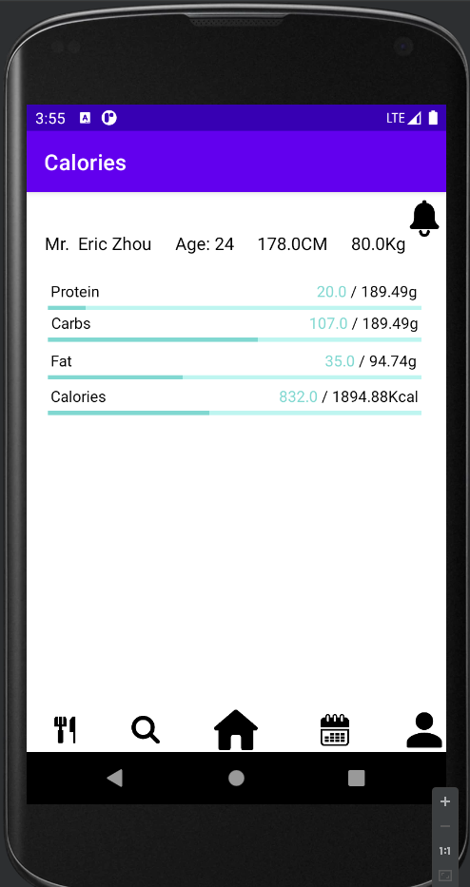
What is Calorie?
Android App (Smartphone)
What it can do?
Provide suggested amount of each nutrition
Provide nutrition facts of each food
Help users tracking their food intakes
Provide an array of recommendations of foods
How it works?
Enter body parameters
Add/Delete food
Get recommendations & Suggestions
Enjoy :)

Slide 6
Technical Approach
Build Personal Model
Personal Information
Daily Weight Update
Use API as nutrition fact library
Edamam API
Add/Delete Meal
Tap to add
Swipe to delete
Gesture is much easier
Recommendation
Spoonacular API
Do the math for user
Recommend food based on current intakes.
Not just for one meal.

Slide 7
Others
Data Storage
Bmob - Store and retrieve some heavy data (Eg. Nutrition facts)
Shared Preference - Store and retrieve some light data (Eg. User’s age, name, etc.)
Connecting with API
Okhttp
The Weight Trend Plot
GraphViews
Present the image
Glide

Slide 8
Demo
Jiawen will give a five-minute demo here :)

Slide 9
What’s Coming Next
Loading page and login page for the App
Improve the speed of retrieving data from the backend.
Connect to Google Fit API.
Add more parameters to personal models (Mealtime, sleeping, etc.)

Slide 10
Thanks for watching!
Appreciate your time!!:D

